Slide 1
Kashaya
Speakers: Bun Lucas, Anita Silva, Essie Parrish
Images: Essie Parrish
Audio file source: Kashaya Vocabulary Lists by Prof. Gene Buckley
(http://www.ling.upenn.edu/~gene/Kashaya/Vocabulary/index.html)

Slide 2
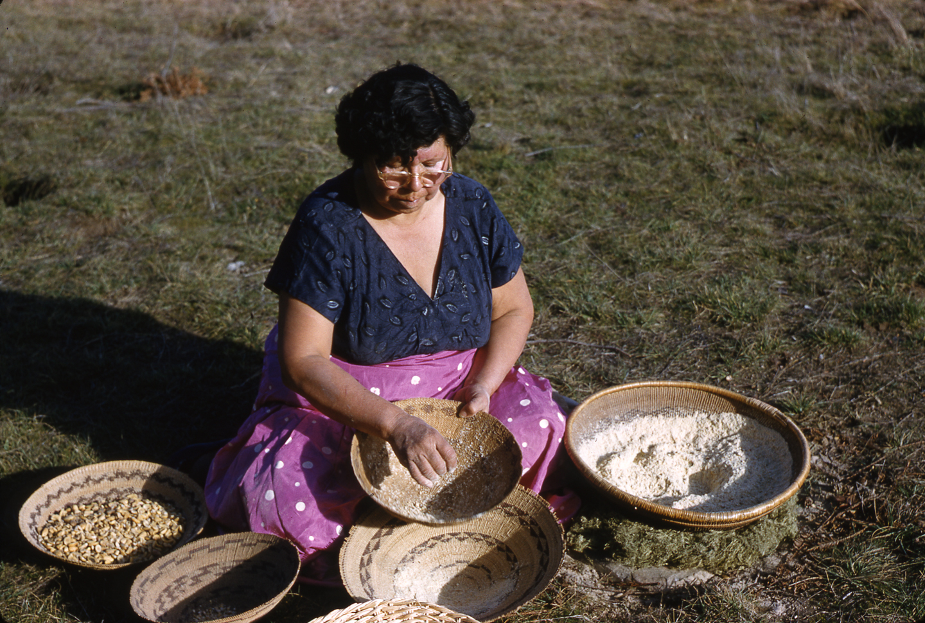
šamʔ
Work tray basket
Biʔdu
Acorn

Slide 3
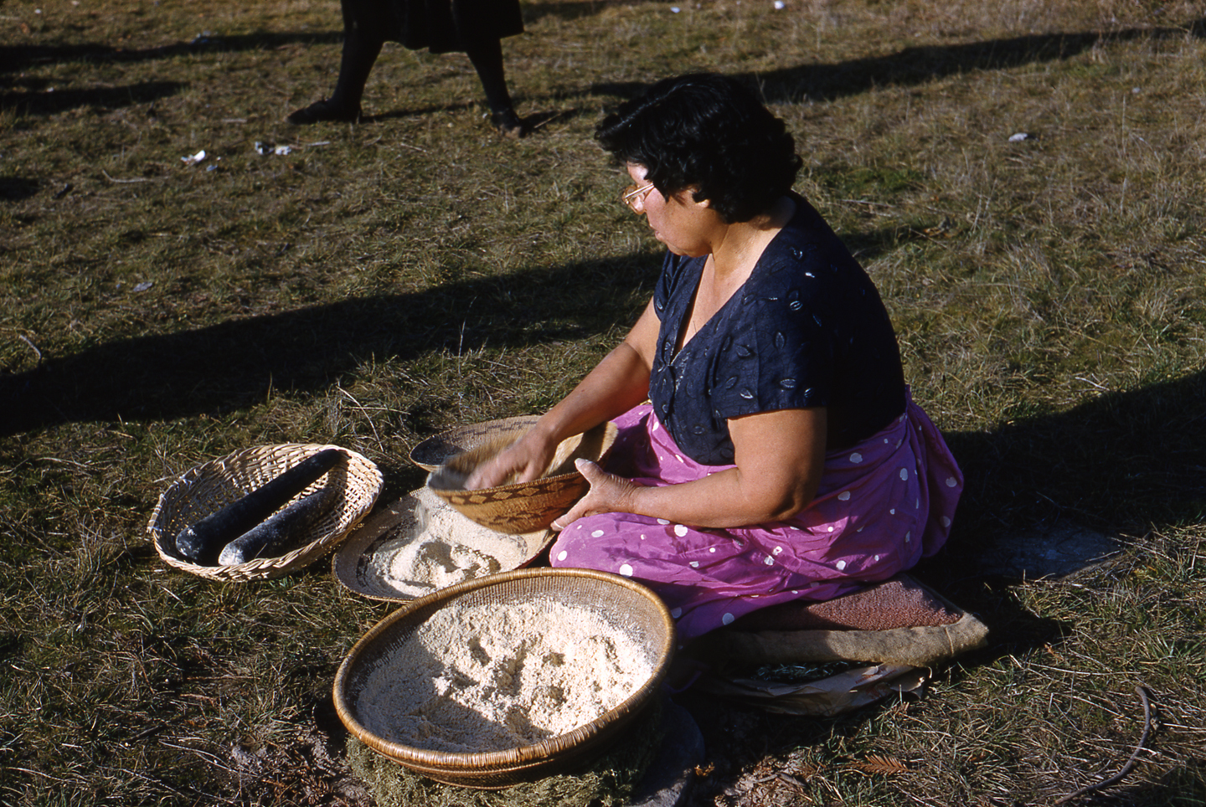
šamʔ
Work tray basket
biʔdu
Acorn
duhkul
Pestle

Slide 4
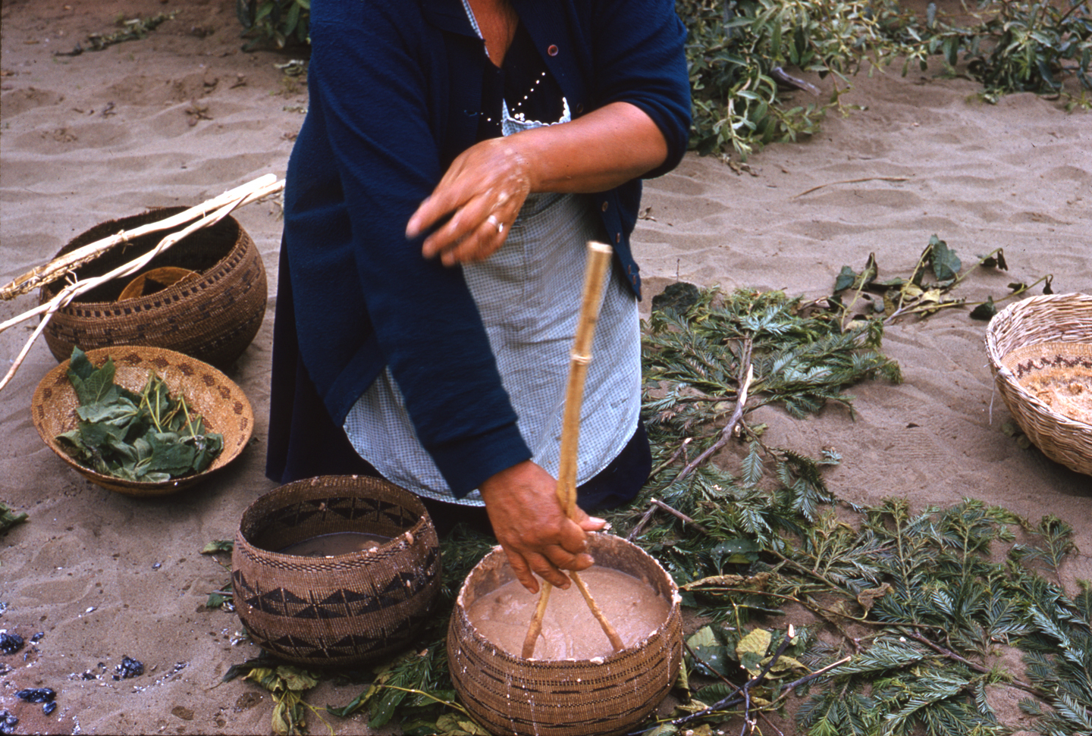
šeʔeʔ
Cooking basket
ṭʰoʔo
Acorn mush

